Slide 1

Understanding
Relationships
and
Health Education
@ Castle School
a guide for parents

Slide 2
·Respecting and valuing ourselves and others.
·Having fun learning, playing, and socialising.
·Aiming high and celebrating success.
·Preparing for life in the wider community.
Our School Aims:

Slide 3
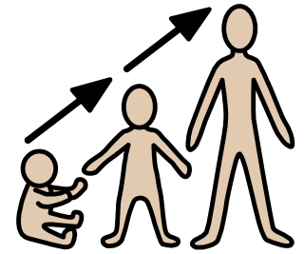


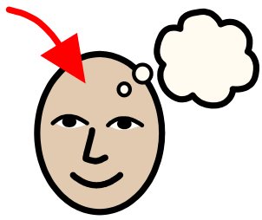
What's changed?
It is now statutory for both Primary and Secondary to be taught Relationship and Health Education
It is also compulsory for Secondary to be taught Sex Education.

Slide 4


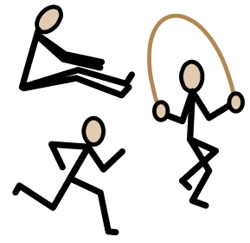
Primary
So what does Relationship and Health Education cover?
Relationship Education
·Families and people who care for me
·Caring friendships
·Respectful relationships
·Online relationships
  ·Being safe
TM
Health Education
·Mental wellbeing
  ·Physical health and fitness
·Healthy eating
·Health and prevention
  ·Basic first aid
  ·Changing adolescent body

Slide 5

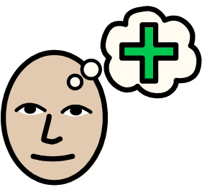
Secondary
So what does Relationship and Health Education cover?
Relationship Education
·Families
·Respectful relationships
·Online and Media
·Being safe
·Sexual relationships and sexual health
TM
Health Education
·Mental wellbeing
  ·Physical health and fitness
·Healthy eating
·Health and prevention
  ·Basic first aid
·Changing adolescent body
  ·Drugs, Alcohol and Tobacco

Slide 6

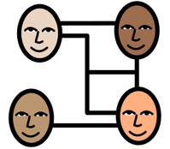
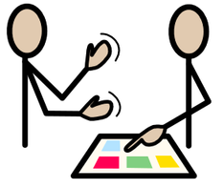

Cognition/ Independence
Social and Emotional
Toileting/ Feeding/ Dressing
Making choices
Behaviour
Moving around inside/outside
understanding cause and effect
Problem solving
Creativity
Investigating
Generalising skills learnt
English/Maths/Life skills
Self awareness
Self-esteem
Likes/dislikes
Social understanding/social cues
Structured/unstructured play
Mental health and well-being
Sharing/turn taking
Self-control/ empathy
Building strong relationships
How does this look at Castle?
Communication
Sensory and Physical
Teaching through Education, Health and Care Plan Outcomes
Gross/fine-motor skills
Personal care
Feeding and eating
Sensory integration
Swimming/ P.E.
Horse-riding
Language/ symbols/ Makaton/ AAC
Motivation to communicate
Expressive/ receptive language
Play behaviour and communicating to others
Conversational skills (Intensive Interactions to verbal communication)
Asking for needs/wants appropriately

Slide 7
The curriculum...
...is matched to the child’s needs and level of development.

Slide 8






For some pupils it will be appropriate to
teach...
Sexually Transmitted Disease
and
HIV/AIDS
Puberty
Online Safety
Contraception
and Abortion
Consent
Drugs/Alcohol
Sexual Identity

Slide 9
Parental right
to withdraw their child
from lessons
You cannot withdraw your child from Relationships Education as it is now considered a statutory part of the curriculum.
If you do not want your child to take part in some or all of the lessons on Sex Education you can ask that they are withdrawn.
The science curriculum also includes content on human development, including reproduction, which there is no right to withdraw from. However, as already stated, we will only teach content which we feel children are developmentally ready for, and we welcome input from parents in deciding what is or is not appropriate.

Slide 10





Parental views
on Relationships and
Health Education
at Castle School
We welcome your thoughts.
Please feel free to discuss this with your child’s class teacher.
Contact PHSE Coordinators, Howai Lam or Peter Nelmes.
Share your views through our online survey.
We will be holding a consultation session with parents at a later date.

