Slide 1
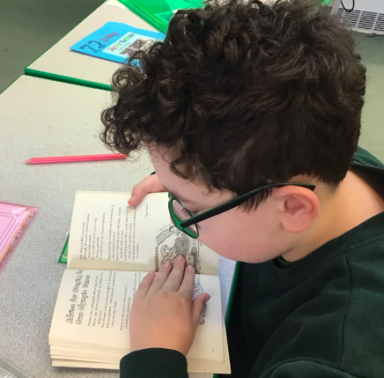
Formal
Assessment & accreditation
Assessment based on EHCP targets, Maths and English Castle Levels and PSHE, as well as individual frameworks in discrete subject areas. It is accredited with entry levels or GCSEs where appropriate.
For secondary learners working towards Entry Level qualifications
a rich subject-based academic curriculum
adapted to needs, interests, and learning styles
builds towards formal qualifications
encourages exploration of interests and knowledge of wider world

Slide 2

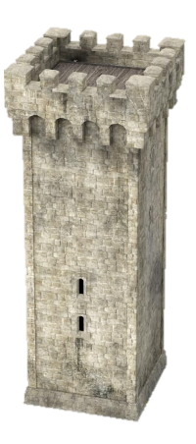


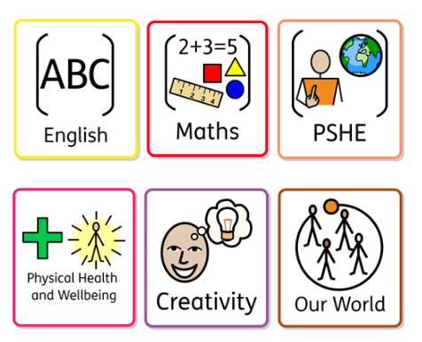

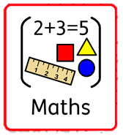


Formal Literacy aims:
Enhance reading and writing proficiency
Cultivate speaking and listening skills via class discussions
Formal Creativity aims:
Experience a rich variety of art, music, dance, choir, and art projects
Possible 1:1 input from art and music therapists for select learners.
Formal
Formal Numeracy aims:
Build fluency, reasoning and problem-solving skills
Build deep understanding of key mathematical concepts
Formal Physical Health & Wellbeing aims:
Experience and enjoy sports, swimming, cycling, bike ability, fitness suite use, and social walks.
Participate in competitions, tournaments, and sports activities involving other schools
Formal Our World aims:
Expand global awareness (past, present, future).
Explore artefact boxes, community visits, experiments, and cooking.
Cultivate respect for diverse beliefs.
Formal PSHE aims:
Enhance social and conversation skills
Build knowledge about personal safety, emotional and mental health and wellbeing
Prepare for adulthood
2

